Slide 1

Case Studies
Residual Networks (ResNets)
deeplearning.ai

Slide 2








Residual block
$$a^{[l+1]}$$
$$a^{[l]}$$
$$a^{[l+2]}$$
$$z^{[l+1]}{=W}^{[l+1]}a^{[l]}+b^{[l+1]}$$
$$a^{[l+1]}=g(z^{[l+1]})$$
$$z^{[l+2]}= W^{[l+2]}a^{[l+1]}+b^{[l+2]}$$
$$a^{[l+2]}=g(z^{[l+2]})$$
[He et al., 2015. Deep residual networks for image recognition]

Slide 3


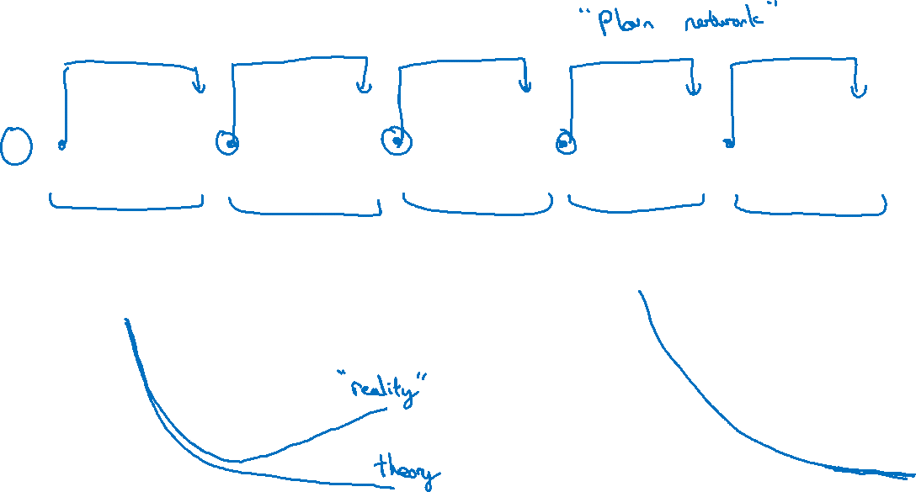
Residual Network
$$x$$
$$a^{[l]}$$
Plain
ResNet
training error
training error
# layers
# layers
[He et al., 2015. Deep residual networks for image recognition]

